Slide 1
-Andrea Weaver, Union County Auditor
-David Phillips, Union County Prosecutor
-Andrew Smarra, Union County Treasurer
Union County
Budget Commission
What is it, and Recent Changes
*Mass Appraisal, Levies, HB 920, Inside Millage,
Legislative Changes*
June 8, 2026

Slide 2

How is Value Determined? Mass Appraisal
State-Mandated Mass Revaluations & Triennials
  Every 6 years we reappraise every parcel on its own merits, nearly 40,000 of them!
  Definitely not the same as fee appraisal; we gather many facts and seeks uniformity, which is required by Ohio law.
  In between reappraisals, we have Triennial Updates
    On the 3rd year post-reappraisal, we update values based on the sales data from the prior 2-3 years.
The Ohio Dept of Taxation (DTE) mandates the % changes for the entire county based on sales occurring since the last update.
The Auditor’s role is not to tax, but to follow the market and assign property values based on local market activity.
Andrea Weaver, Union County Auditor

Slide 3
What is a County Budget Commission and Why is it important
An oversight body who’s core job is to annually review the budgets of local taxing authorities to ensure tax rates are legal, properly authorized by voters, and allocated fairly
  Provides financial oversight and tax relief if excessive taxes are collected and can even reduce tax levies to prevent unnecessary revenue collection
  Dictates the distribution of state funds such as “local government fund”
  Monitors carryover balances and general expenditures, insuring your tax dollars are collected and accounted fore and properly spent according to what was approved by voters.

Slide 4
Recent Changes to the responsibilities of the County Budget Commission
HB 309 – Enacted 2025 effective 3/20/2026
  Expands the Budget Commissions Authority
    Levy Modification and reductions
    Mandatory Hearings
    Unvoted Increase Suspensions
    Levy Approval limits
  Exceptions and Safeguards
    Cannot reduce a school districts operating levies below 20mil floor nor make cuts that would reduce state funding
    Levies collected by a majority-elected body cannot be reduced below prior year revenue unless the reduction is offset by the entities reserve or carryover
    First Year voted levies cannot be reduced
  Appeals Process – Taxing unit can challenge CBC decisons to Board of Tax Appeals

Slide 5

Property Value & Tax Basics
Market value vs Assessed value
  Market value is what the Auditor believes the property would sell for on January 1st of the Tax Year. Ohio law requires that ad valorem taxation occur at Market, and the best indicator of market value is a valid, recent sale.
  Assessed value is the value to which the tax rate is applied, 35% of appraised value.
Tax rates are expressed in mills
  1 mill = $1 of tax for every $1,000 of assessed value
  For example: if your total market valuation is $100,000 and you have a 1 mill new levy, your payment would be: $100,000 x 35% x (1/1000) = $35
Fixed Rate Levies (most common) collect approx. the same amount of revenue year after year. How?
  Reduction factors act to reduce rates when values increase due to inflation (supply & demand). HB 920; 1976
  However, schools have 20 mills and local entities 10 mills which are tied to value*** (HB186, HB 129, HB 335).
4
Andrea Weaver, Union County Auditor

Slide 6
Levies & Effective Tax Rates
Effective tax rate is calculated by measuring the percentage of value change due to the reappraisal and reducing the voted rate (of most operational levies) so that the levy does not generate additional revenue from the reappraisal change
Operational Theory:
  If your value increases due to a reappraisal change it doesn’t mean it costs more money to provide services.
  But If your value increases due to new construction, there is a greater demand for services and thus additional revenue is generated.
Andrea Weaver, Union County Auditor

Slide 7
What is HB 920 and why does it matter?
Signed in 1976
Intended to prevent increases in Real Estate Taxes on voted millage as a result of county revaluation every 3 years
Reduction factor is calculated to reduce the effective millage rate to compensate for higher values
Allows growth in fixed revenue levies for “new” construction
10mils inside millage unaffected
In 1977 HB221 created the 20 mil floor.

Slide 8

Taxes are Relative to Value (ad valorem)
Most voted levies, excluding inside millage, adjust the rate for reappraisal changes.
The tax rate is adjusted based on the value of the subdivision, not the individual property
One rate is established for the entire tax district for each levy. We have 45 tax districts. (Village vs Township vs School District vs Fire District)
  Not everyone’s value changes by the same percentage because not everyone’s value was the same at the start.
Taxes change based on your relative value to the total value of the subdivision
  Think of the total revenue to be generated by a levy as a pie:
  The “pieces of pie” are Class 1, Class 2, PUPP
  The percentage of your property’s value compared to the total value of the subdivision
  is your share of the pie (liability).
  If the percentage increase in your value is greater than the average percentage increase for the subdivision, your share of the liability increases relative to the average, and your taxes will increase even though the levy will produce the same amount of revenue
Andrea Weaver, Union County Auditor

Slide 9
How are levy dollars distributed?
Real Estate and Mobile Home taxes are distributed once collected as part of the “Settlement” between the County Treasurer and County Auditor.
The “Settlement” is the gross amount collected within each taxing district, for each taxing entity, for each levy (at effective rate) less fees.
Union County has 45 taxing districts
A taxing district can have all or a combination of the following: School Distict, JV’s, County, Special District (Health), City or Village, Township, Fire/EMS
We distribute tax collections to taxing entities 2 times per year.

Slide 10
Inside Millage
It’s an unvoted property tax authorized by the Ohio Constitution and GA that cannot exceed 10 mills in ANY tax district.
Minimum guarantee to political subdivisions – only those that were in existence between 1929-1933.
“Free millage”
This is unvoted millage, which means no HB920 tax rate adjustment:
Value x rate = tax
So if values go up, the taxes assessed go up. If values go down, the taxes assessed go down.
Andrea Weaver, Union County Auditor

Slide 11
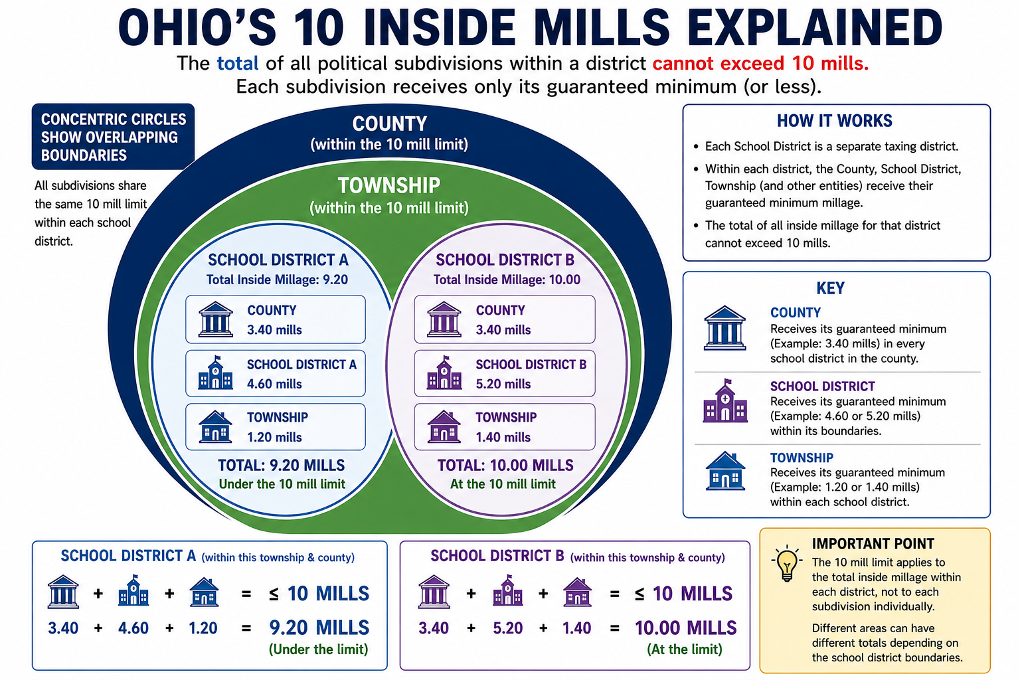
Andrea Weaver, Union County Auditor
10

Slide 12
Recent legislative changes
All of these are designed to limit future tax increases. Not intended to put money back in anyone’s pocket. With the exception of the 2nd half tax credit with HB 186, all are forward-looking and may or may not have an impact.
HB129 – this alters the composition of those levies used in calculating the 20-mill Floor. Fixed Sum levies(Substitute and Emergency) will now be included.
Expected Result? Fewer schools will qualify for the 20-mill floor adjustment. This will keep those large swings/increases in school taxes from happening when there is a countywide update that largely increases school values.
HB186 – this is designed to initially calculate a give back/credit to homeowners who live in a school district on the 20-mill floor and then to cap inflationary revenue growth to the rate of inflation.
2 parts:
*Because the Legislature wasted lots of time, this adjustment has turned into a HUGE challenge for those of us are tasked with completing it. It is to be a second half, ty 2025 adjustment. If it happens, it will be a miracle. Highly likely that tax bills will be delayed, as will the second half collection. The complexity of the task and the limitations in the legislation have become a communication challenge.
*The amount of the credit will be small; not every school.
*This is the ONLY legislative action that will put some money back in taxpayers’ pockets. All of the others seek to minimize increases. Inflationary adjustment will be applied . ***hb335; hb129
Andrea Weaver, Union County Auditor

Slide 13
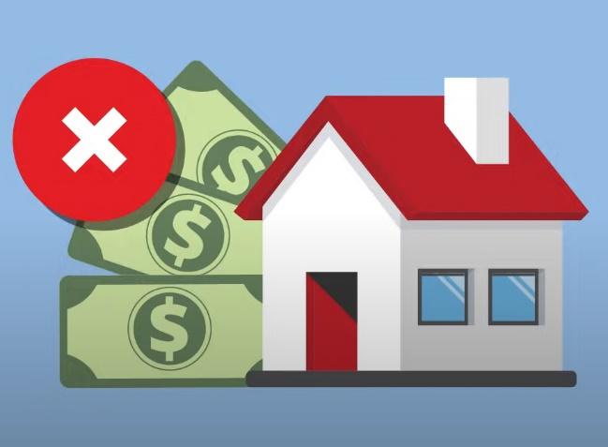
Recent legislative changes
HB 186: NOTE: there is an additional part of this bill to adjust the owner-occupancy and non-business credits – to gradually increase the OOC over the next 4 year and eliminate the NBC. At the end of the period, the OOC will be 15.38% and the NBC will be zero.
  Currently, homeowners receive 12 ½%, so the final net credit increase to homeowners will be 2.88% of additional credit over the 4 years of implantation
  Ag and non-timber properties will not lose the 10%/NBC.
HB 335: Essentially this does for all of the other local governments that receive statutory Inside Millage what HB186 does for schools.
*The intent is to limit future revenue growth.
*So there are no immediate tax benefits, no refunds or credits, but the next countywide update, these rules will be implemented. Your taxes may still increase but not by as much.
HB 309: Budget Commission – emphasized scrutiny; local decisions
Andrea Weaver, Union County Auditor

Slide 14

THE MOST IMPORTANT PART
Andrea Weaver, MBA. AAS, Union County Auditor
233 W. 6th Street, Marysville, OH 43040
937-645-3003
aweaver@unioncountyohio.gov

